Slide 2
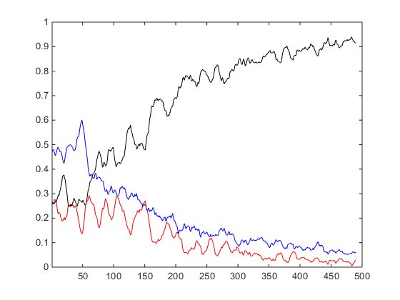
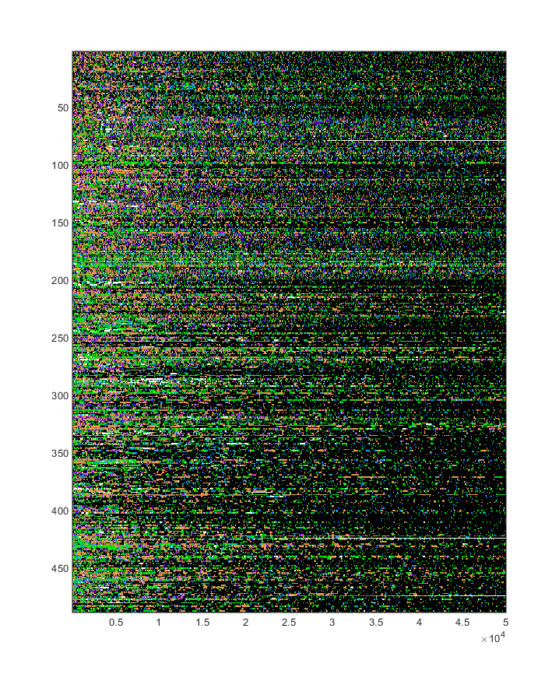
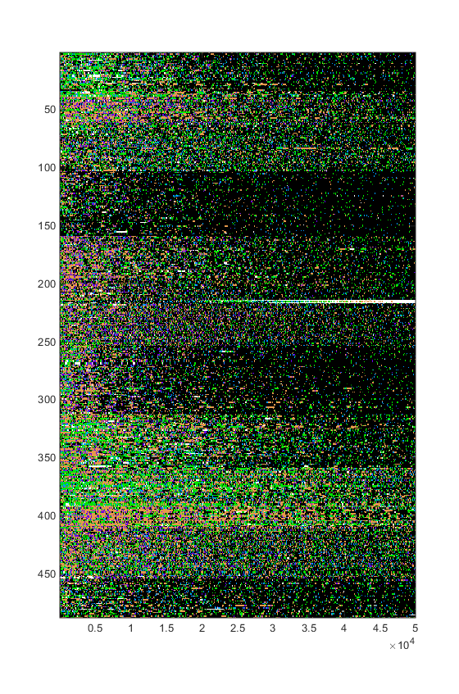
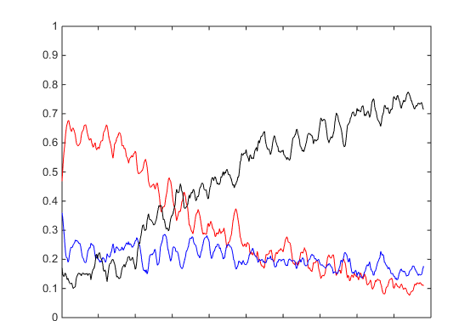
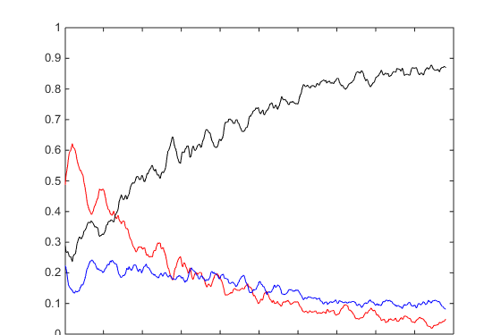
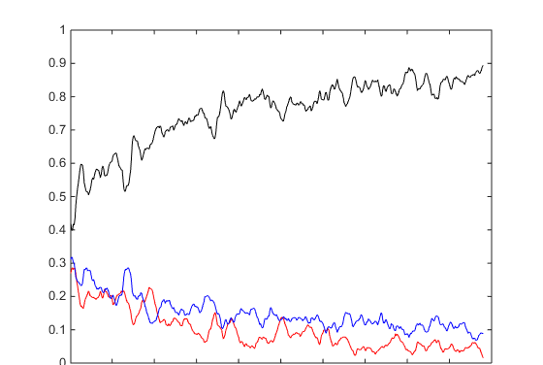
D
Examples of progression
A
Class “1”
Ethogram showing behavior in one fly
P (behavior)
0
Time [sec]
1700
B
Stack of 487 ethograms
C
Sorted stack of 487 ethograms
Class “3”
P (behavior)
Class “6”
Sort ethograms
P (behavior)
16 classes
Class “15”
P (behavior)
0
Time [sec]
1700
0
Time [sec]
1700
0
Time [sec]
1700

Slide 3
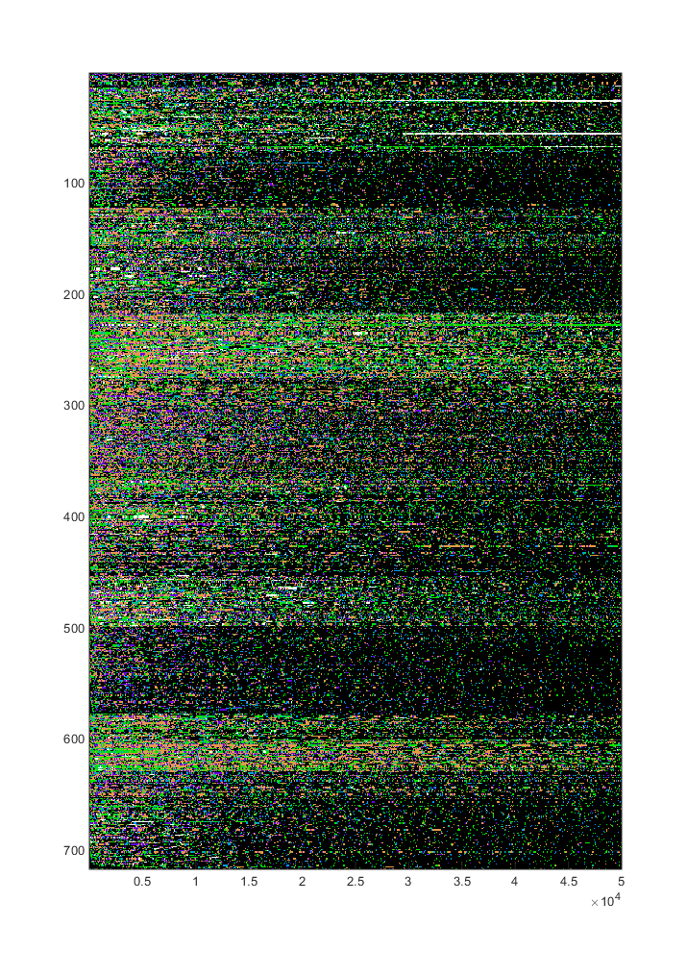
Ethograms sorted TP (49 states * 10 windows) w=5000; st=5000
Syntax sorted TP (49 states * 10 windows) w=5000; st=5000

Slide 4
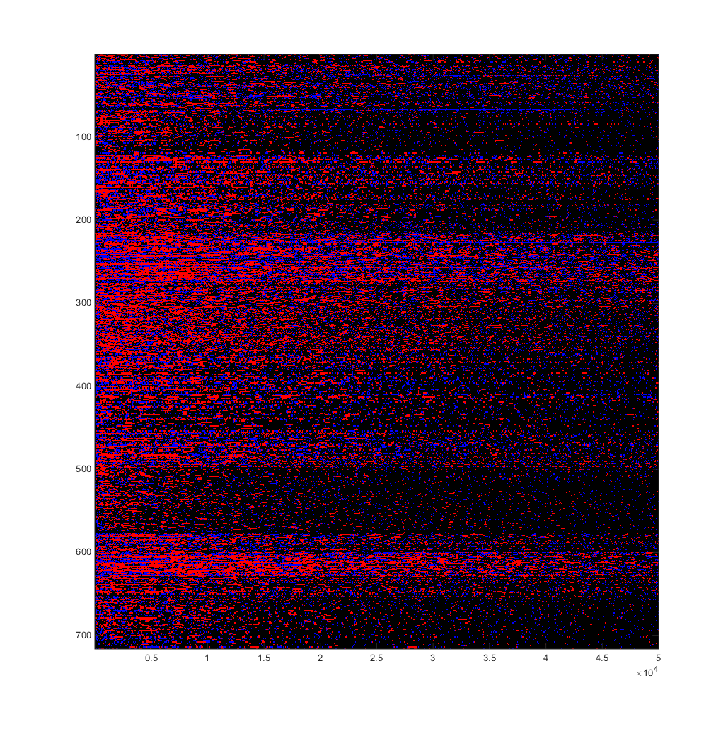
Syntax sorted w=5000; st=5000

Slide 5
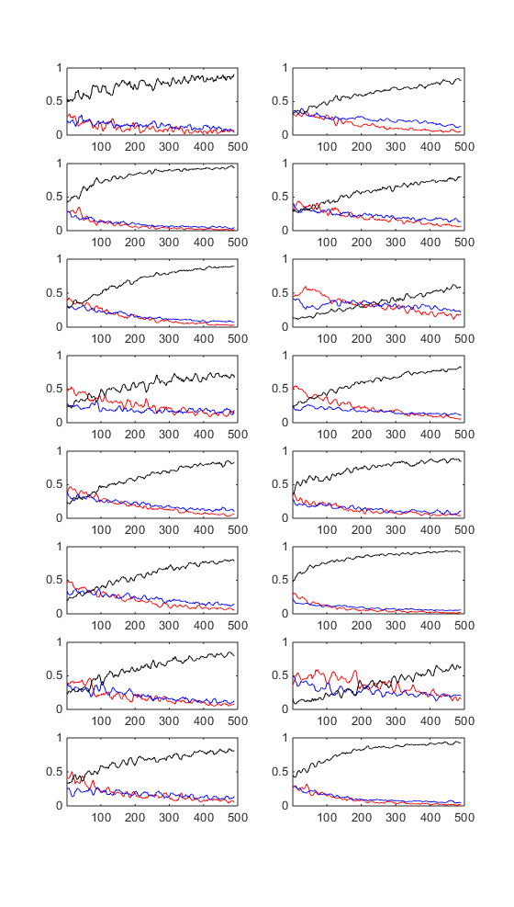
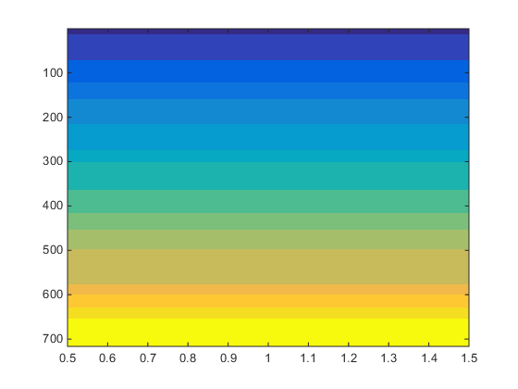
Syntax sorted w=5000; st=5000

Slide 6
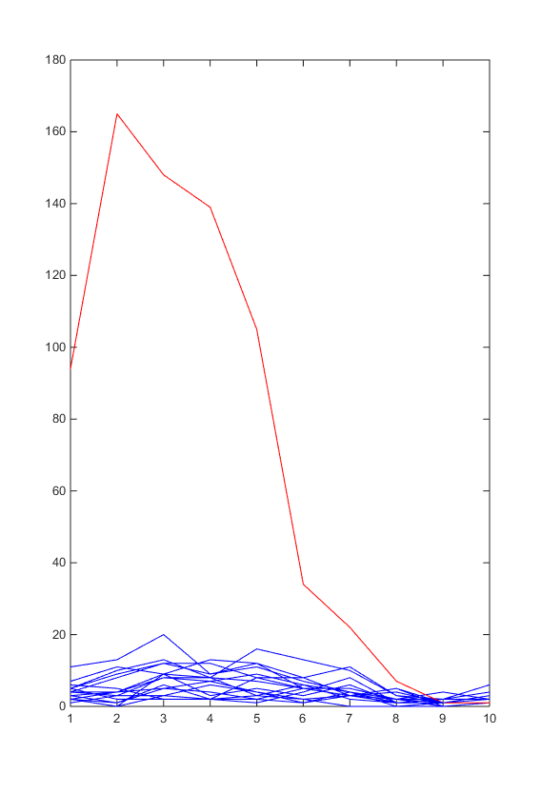

Slide 7
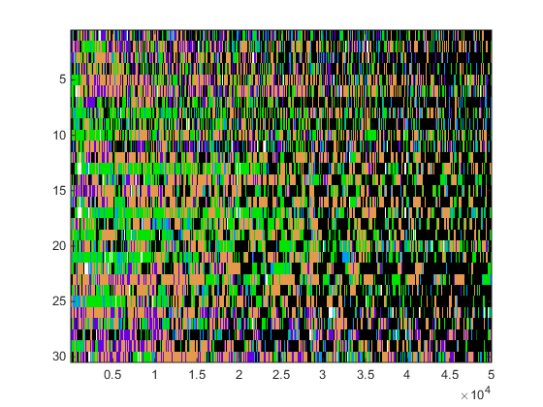

Slide 8
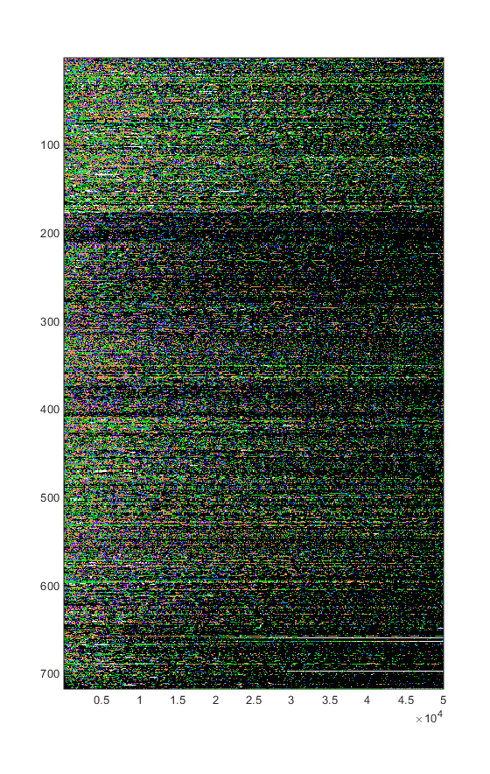
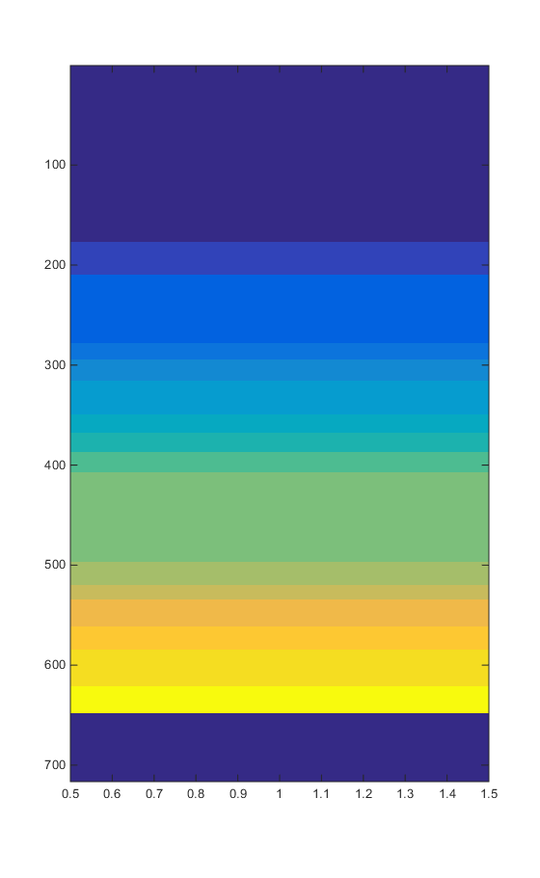
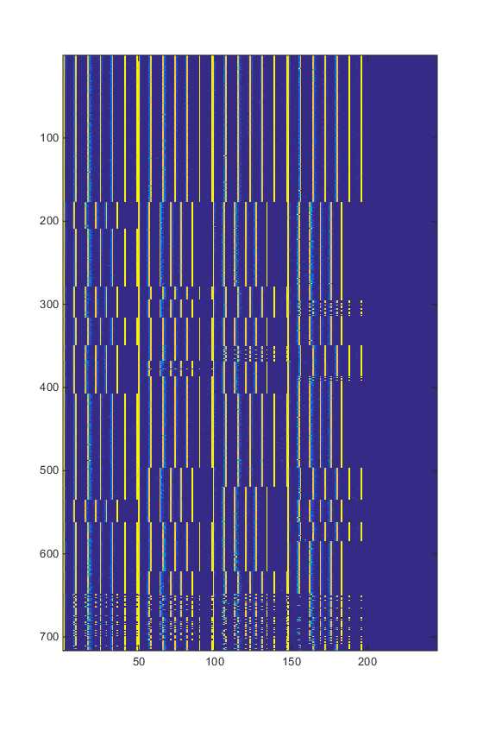
Normalized Syntax sorted TP (49 states * 5 windows) w=10000; st=10000

Slide 9
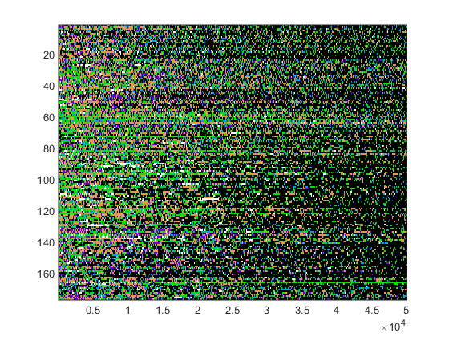
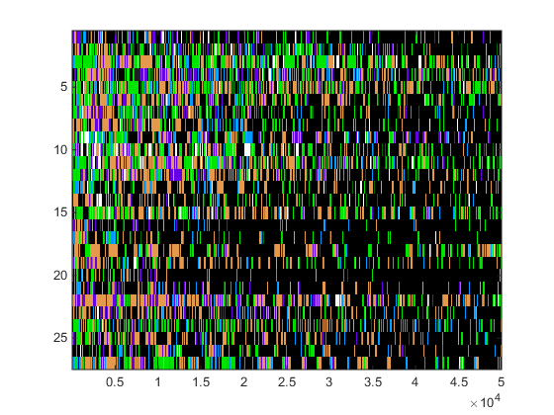

Slide 10
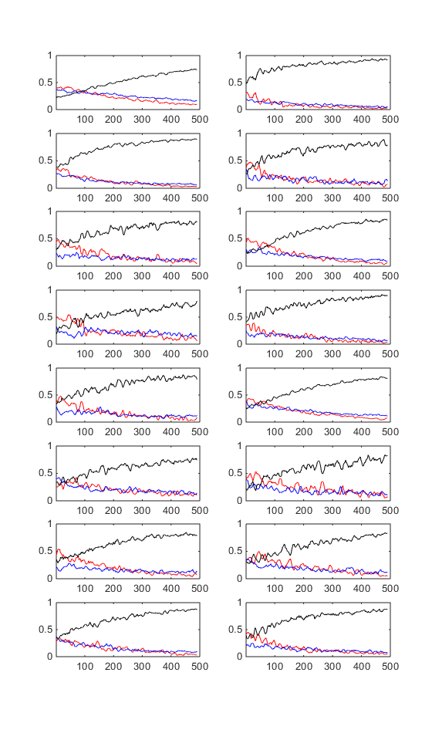
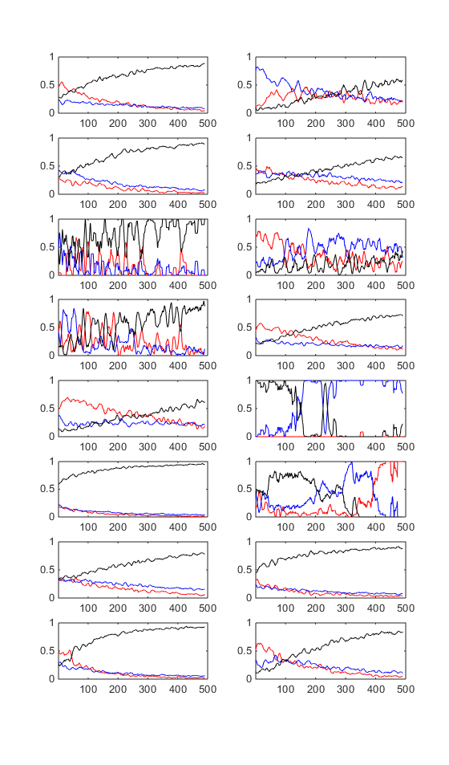
Freq. classification
Syntax classification

Slide 11
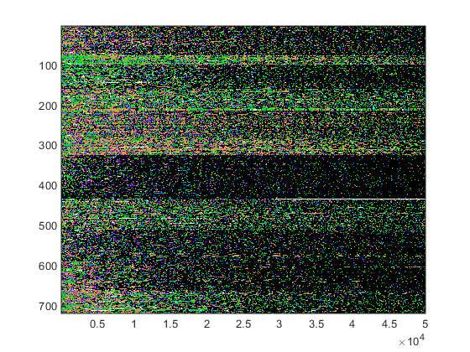
Freq. classification

Slide 12
Normalized Syntax sorted TP (49 states * 5 windows) w=10000; st=10000

Slide 13
Normalized Syntax sorted TP (49 states * 5 windows) w=10000; st=10000

